Slide 1
Linear Regression and Gradient Descent
Jun Hong

Slide 2
Outline
In this lecture:
Basics of linear regression which lays the foundations of many other ML algorithms
Notation used in machine learning algorithms
How gradient descent works
How to use gradient descent to train a linear model
How stochastic gradient descent works
How to use stochastic gradient descent to train a linear model

Slide 3
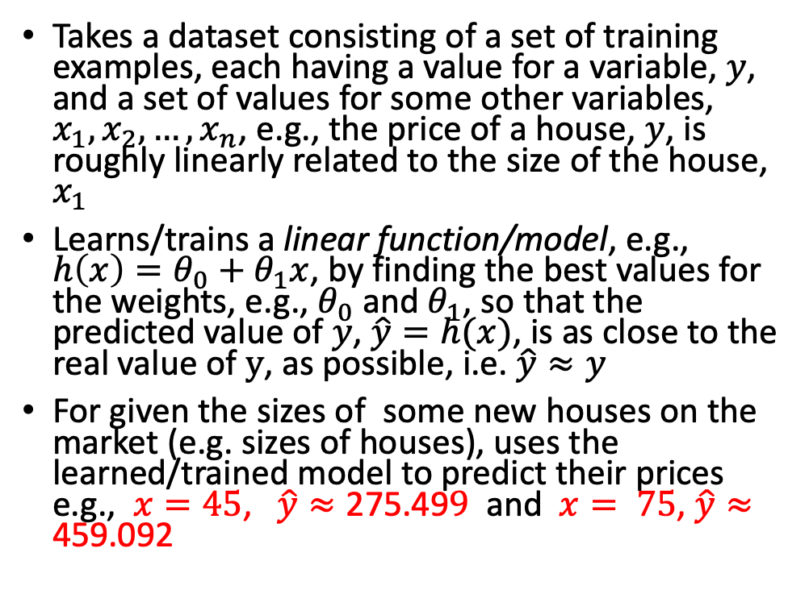
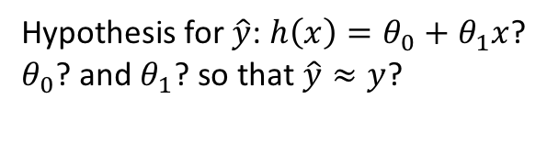
Linear Regression – An Example
Takes a dataset consisting of a set of training examples, each having a value for a variable, $y$, and a set of values for some other variables, $x_{1},x_{2}, …,x_{n}$, e.g., the price of a house, $y$, is roughly linearly related to the size of the house, $x_{1}$
Learns/trains a linear function/model, e.g., $h\left(x\right)=θ_{0}+θ_{1}x$, by finding the best values for the weights, e.g., $θ_{0}$ and $θ_{1}$, so that the predicted value of $y$, $\hat{y}=h(x)$, is as close to the real value of $y$, as possible, i.e. $\hat{y}≈y$
For given the sizes of some new houses on the market (e.g. sizes of houses), uses the learned/trained model to predict their prices e.g., $x=45$, $\hat{y}≈\text{275.49}9$ and $x= 75$, $\hat{y}≈\text{459.092}$
Hypothesis for $\hat{y}$: $h\left(x\right)=θ_{0}+θ_{1}x$?
$θ_{0}$? and $θ_{1}$? so that $\hat{y}≈y$?
Notes:
Those highlighted values are from linear-regression-gradient-decent-sklearn.ipynb used in Practical 1.

Slide 4
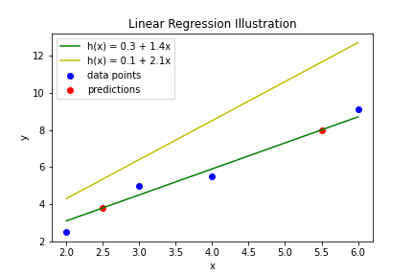
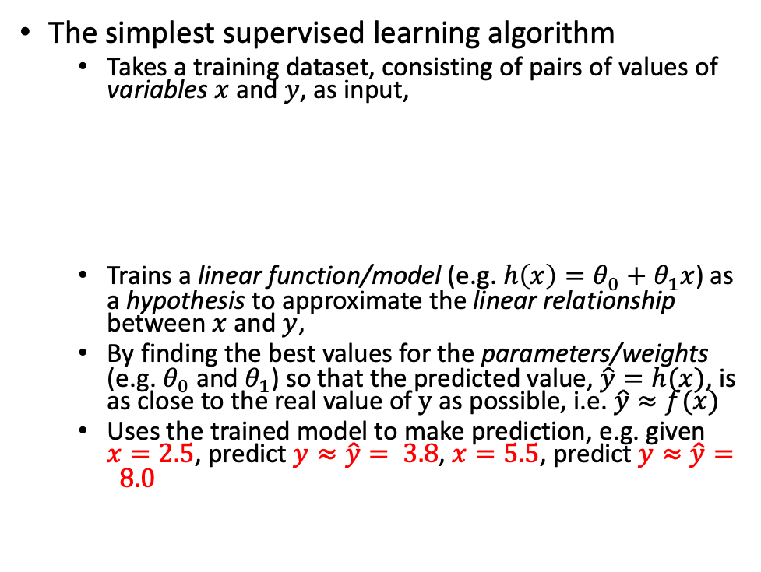


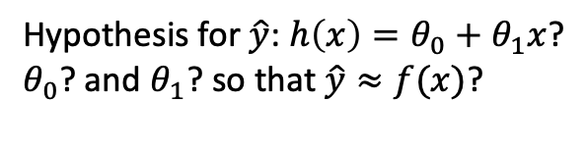
Linear Regression – Intuition
The simplest supervised learning algorithm
  Takes a training dataset, consisting of pairs of values of variables $x$ and $y$, as input,
  Trains a linear function/model (e.g. $h\left(x\right)=θ_{0}+θ_{1}x$) as a hypothesis to approximate the linear relationship between $x$ and $y$,
  By finding the best values for the parameters/weights (e.g. $θ_{0}$ and $θ_{1}$) so that the predicted value, $\hat{y}=h(x)$, is as close to the real value of $y$ as possible, i.e. $\hat{y}≈f(x)$
  Uses the trained model to make prediction, e.g. given $x=2.5$, predict $y≈\hat{y}= 3.8$, $x=5.5$, predict $y≈\hat{y}= 8.0$
Hypothesis for $\hat{y}$: $h\left(x\right)=θ_{0}+θ_{1}x$?
$θ_{0}$? and $θ_{1}$? so that $\hat{y}≈f(x)$?
$$x$$
$$\left[\begin{aligned}\begin{matrix}2 \\ 3 \\ 4\end{matrix} \\ 6\end{aligned}\right]$$
$$y$$
$$\left[\begin{aligned}\begin{matrix}2.5 \\ 5.0 \\ 5.5\end{matrix} \\ 9.1\end{aligned}\right]$$
Notes:
Each training example is a pair of values though $x$ can be a set of values represented as a vector (multi-dimensional). Choosing different sets of values for the weights will form different models that have different levels of performance in terms of how close the predicted values are to the given values.
Note that the actual function $f(x)$ is unknown.

Slide 5
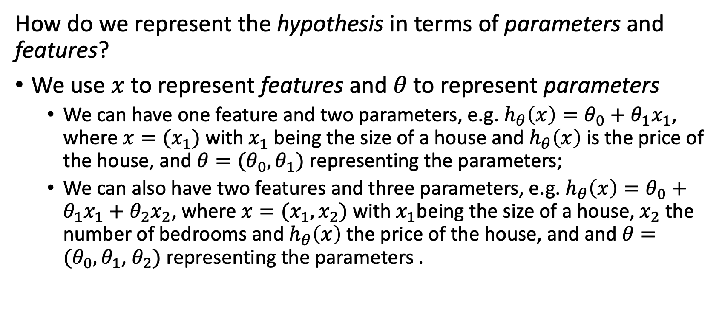
Notation - Representing the Hypothesis, Parameters and Features
How do we represent the hypothesis in terms of parameters and features?
We use $x$ to represent features and $θ$ to represent parameters
  We can have one feature and two parameters, e.g. $h_{θ}\left(x\right)=θ_{0}+θ_{1}x_{1}$, where ${x=(x}_{1})$ with $x_{1}$ being the size of a house and $h_{θ}\left(x\right)$ is the price of the house, and $θ=(θ_{0}, θ_{1})$ representing the parameters;
  We can also have two features and three parameters, e.g. $h_{θ}\left(x\right)=θ_{0}+θ_{1}x_{1}+θ_{2}x_{2}$, where $x=(x_{1}, x_{2})$ with $x_{1}$being the size of a house, $x_{2}$ the number of bedrooms and $h_{θ}\left(x\right)$ the price of the house, and and $θ=(θ_{0}, θ_{1}$, $θ_{2})$ representing the parameters .
Notes:
On this slide, note that the features and the parameters have been represented as two vectors respectively.
Here are two very good tutorials on linear algebra:
A friendly introduction to linear algebra for ML (ML Tech Talks), https://www.youtube.com/watch?v=LlKAna21fLE
Vectors | Chapter 1, Essence of linear algebra, https://www.youtube.com/watch?v=fNk_zzaMoSs

Slide 6
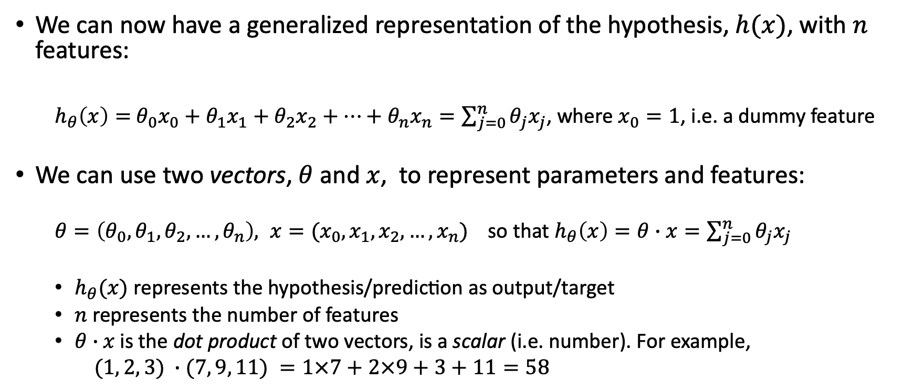
Notation - Representing the Hypothesis, Parameters and Features Using Vectors
We can now have a generalized representation of the hypothesis, $h(x)$, with $n$ features:
  $h_{θ}\left(x\right)=$ $θ_{0}x_{0}+θ_{1}x_{1}+θ_{2}x_{2}+…+θ_{n}x_{n}=\sum_{j=0}^{n}{θ_{j}x_{j}}$, where $x_{0}=1$, i.e. a dummy feature
We can use two vectors, $θ$ and $x$, to represent parameters and features:
  $θ=\left(θ_{0},θ_{1},θ_{2}, …,θ_{n}\right), x=(x_{0},x_{1},x_{2}, …,x_{n})$ so that $h_{θ}\left(x\right)=θ∙x=\sum_{j=0}^{n}{θ_{j}x_{j}}$
  $h_{θ}(x) \text{represents} \text{the} \text{hypothesis}\text{/}\text{prediction} \text{as} \text{output}\text{/}\text{target}$
  $n$ represents the number of features
  $θ∙x \text{is} \text{the} \text{dot} \text{product} \text{of} \text{two} \text{vectors}$, is a scalar (i.e. number). For example,
  $(1, 2, 3) ∙(7, 9, 11) =1×7+2×9+3+11=58$
Notes:
We can intuitively consider a vector as a 1-dimensional array or a list of elements.
The dot product of two vectors is the sum of pair-wise products of the vectors.
$θ_{0}$ is often called bias, i.e. given the values of all variables, multiplied by their weights, how much do we want to increase or decrease the sum of their weighted values. As the value of $θ_{0}$ is completely independent of all the variables, it’s subjective rather than objective to the data, therefore it’s a kind of bias.

Slide 7
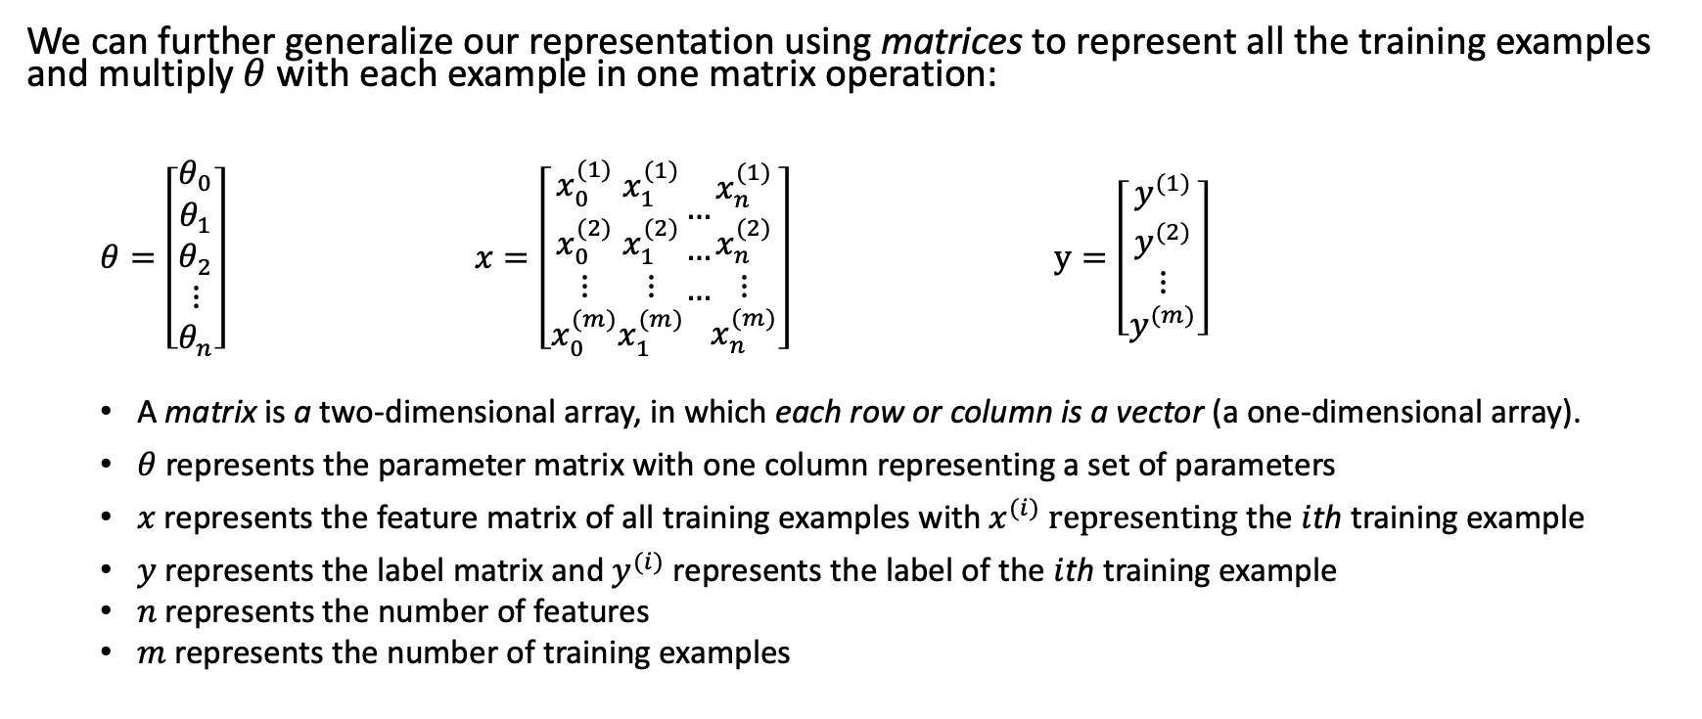
Notation - Representing the Hypothesis, Parameters and Features Using Matrices
We can further generalize our representation using matrices to represent all the training examples and multiply $θ$ with each example in one matrix operation:
  $θ=\left[\begin{matrix}θ_{0} \\ θ_{1} \\ \begin{aligned}θ_{2} \\ ⋮ \\ θ_{n}\end{aligned}\end{matrix}\right]$ $x=\left[\begin{aligned}\begin{matrix}x_{0}^{(1)} \\ x_{0}^{(2)} \\ ⋮\end{matrix} \\ x_{0}^{(m)}\end{aligned}\begin{matrix}\begin{aligned}x_{1}^{(1)} \\ x_{1}^{(2)}\end{aligned} \\ ⋮ \\ x_{1}^{(m)}\end{matrix}\begin{matrix}… \\ … \\ …\end{matrix}\begin{matrix}\begin{aligned}x_{n}^{(1)} \\ x_{n}^{(2)}\end{aligned} \\ ⋮ \\ x_{n}^{(m)}\end{matrix}\right]$ $y=\left[\begin{aligned}\begin{matrix}y^{(1)} \\ y^{(2)} \\ ⋮\end{matrix} \\ y^{(m)}\end{aligned}\right]$
  A matrix is a two-dimensional array, in which each row or column is a vector (a one-dimensional array).
  $θ$ represents the parameter matrix with one column representing a set of parameters
  $x$ represents the feature matrix of all training examples with $x^{(i)}$ representing the $i$th training example
  $y$ represents the label matrix and $y^{(i)}$represents the label of the $i$th training example
  $n$ represents the number of features
  $m$ represents the number of training examples
Notes:
We often use a matrix to represent a set of vectors as we often have a set of training examples and multiple sets of parameters.
When we have multiple models, i.e. multiple sets of parameters, we have multiple columns in $θ$ so also have multiple columns in $y$ that represent the predictions made by multiple models on multiple training examples. But we typically work on a model with a set of parameters at a time.
Note these are the data structures that we use in sklearn when we use them with an ML algorithm.

Slide 8
Multiplication of Two Matrices – An Example
The multiplication of two matrices is calculated by doing the dot product of each row (a vector) in the first matrix and each column (a vector) in the second matrix:
Notes:
$$\left(1, 2, 3\right)∙\left(7, 9, 11\right)=1×7+2×9+3×11=58$$

Slide 9
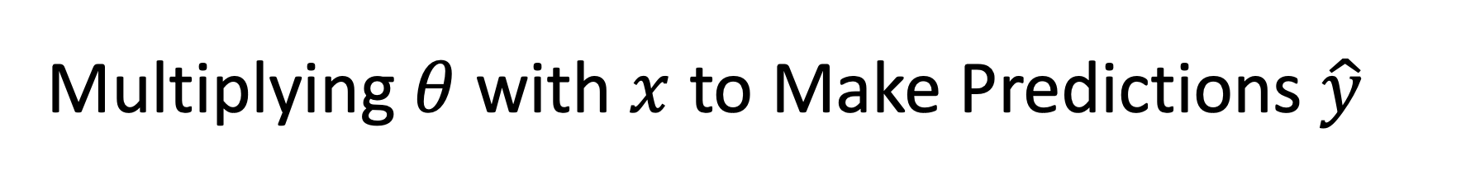
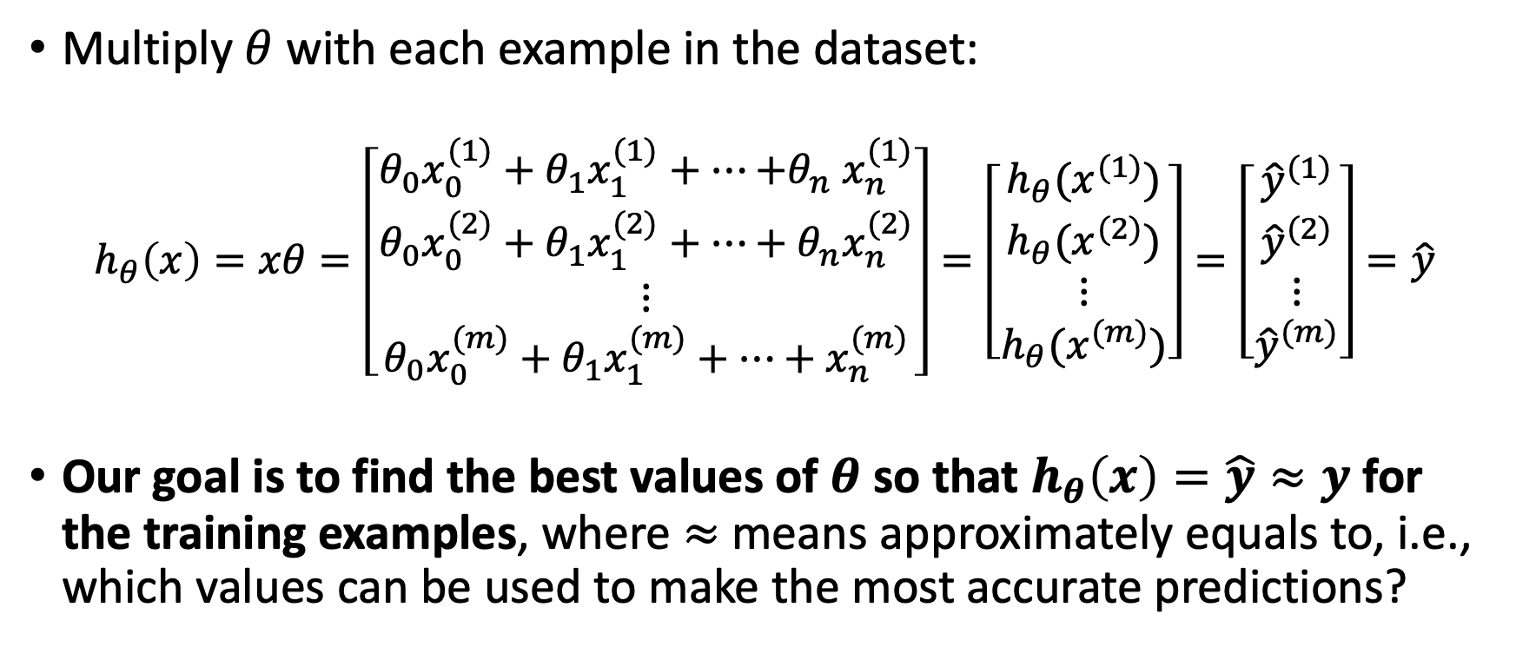
Multiplying $θ$ with $x$ to Make Predictions $\hat{y}$
Multiply $θ$ with each example in the dataset:
  $$h_{θ}\left(x\right)=xθ=\left[\begin{aligned}\begin{matrix}{θ_{0}x}_{0}^{(1)}+θ_{1}x_{1}^{(1)}+⋯{+θ}_{n}x_{n}^{(1)} \\ {θ_{0}x}_{0}^{(2)}+θ_{1}x_{1}^{(2)}+⋯+θ_{n}x_{n}^{(2)} \\ ⋮\end{matrix} \\ {θ_{0}x}_{0}^{(m)}+{θ_{1}x}_{1}^{(m)}+⋯+x_{n}^{(m)}\end{aligned}\right]=\left[\begin{aligned}\begin{matrix}h_{θ}(x^{(1)}) \\ h_{θ}(x^{(2)}) \\ ⋮\end{matrix} \\ h_{θ}(x^{(m)})\end{aligned}\right]=\left[\begin{aligned}\begin{matrix}{\hat{y}}^{(1)} \\ {\hat{y}}^{(2)} \\ ⋮\end{matrix} \\ {\hat{y}}^{(m)}\end{aligned}\right]=\hat{y}$$
Our goal is to find the best values of $θ$ so that $h_{θ}\left(x\right)=\hat{y}≈y$ for the training examples, where $≈$ means approximately equals to, i.e., which values can be used to make the most accurate predictions?
Notes:
Note y hat is also a matrix of one column.

Slide 10
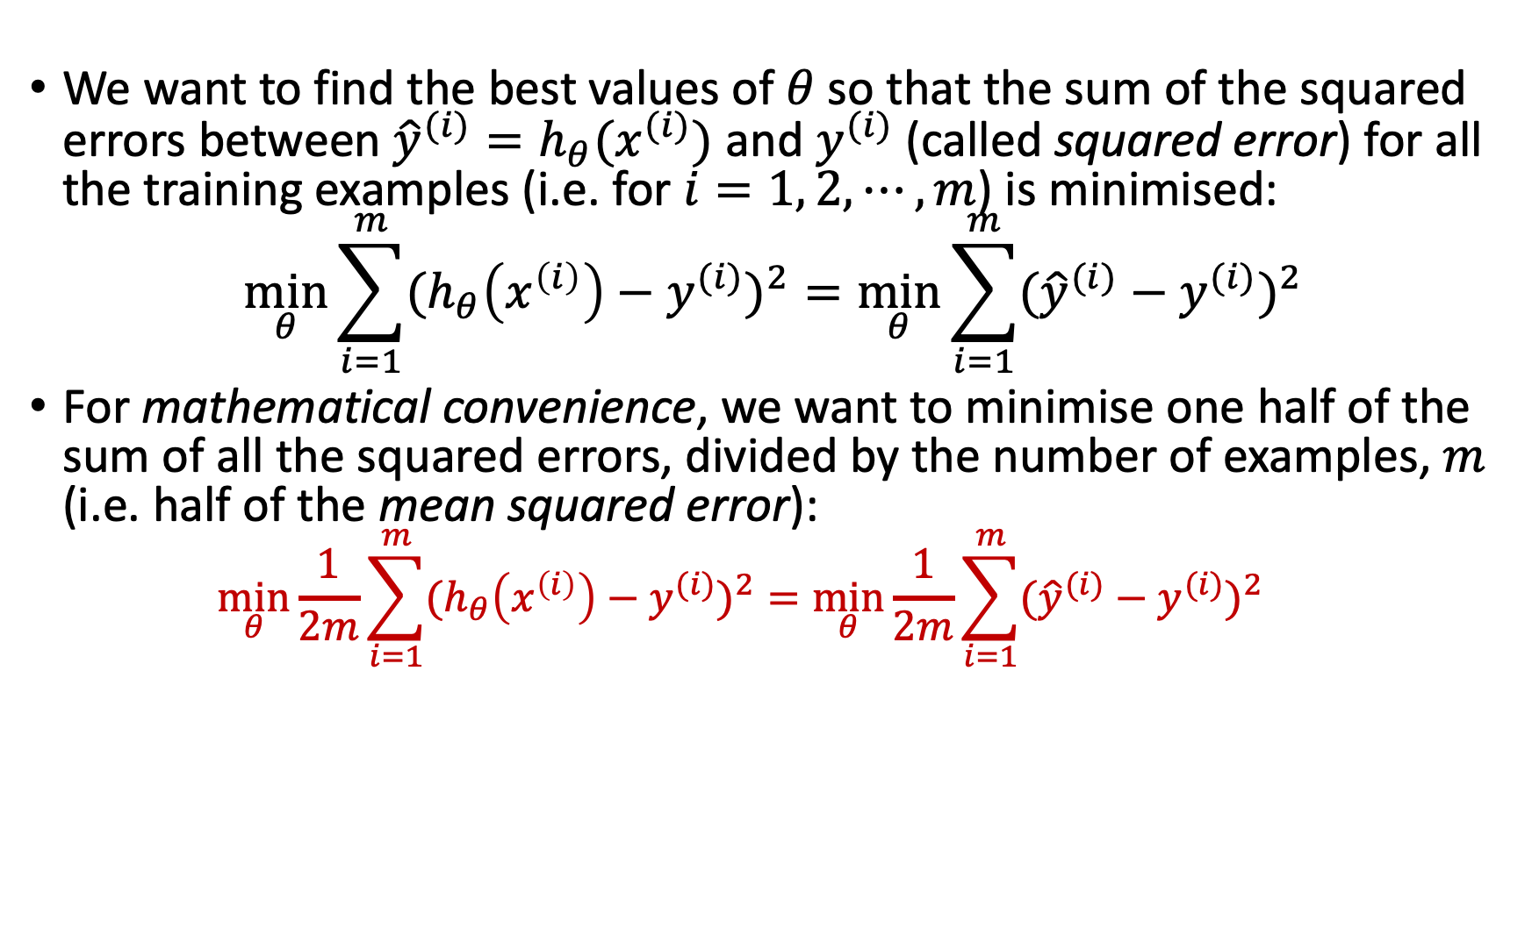
Measuring Errors – Squared Errors
We want to find the best values of $θ$ so that the sum of the squared errors between ${{\hat{y}}^{(i)}=h}_{θ}(x^{(i)})$ and $y^{(i)}$ (called squared error) for all the training examples (i.e. for $i=1, 2, ⋯, m$) is minimised:
$$\min_{θ}{\sum_{i=1}^{m}{{(h_{θ}\left(x^{\left(i\right)}\right)−y^{(i)})}^{2}}}=\min_{θ}{\sum_{i=1}^{m}{{({\hat{y}}^{(i)}−y^{(i)})}^{2}}}$$
For mathematical convenience, we want to minimise one half of the sum of all the squared errors, divided by the number of examples, $m$ (i.e. half of the mean squared error):
  $$\min_{θ}\frac{1}{2m}{\sum_{i=1}^{m}{{(h_{θ}\left(x^{\left(i\right)}\right)−y^{(i)})}^{2}}}=\min_{θ}\frac{1}{2m}{\sum_{i=1}^{m}{{({\hat{y}}^{(i)}−y^{(i)})}^{2}}}$$
Notes:
Using square error corresponds to a Gaussian.
Q: Why do we need to divide by $m$, the number of examples?
The following is from Google AI Overview:
Squared error is used in statistics and regression analysis for a number of reasons, including:
Equalizes positive and negative errors
Squaring the error value makes all values positive, which treats positive and negative errors equally.
Prevents cancellation of errors
Squaring the error prevents positive and negative errors from cancelling each other out.
Increases impact of larger errors
Squaring the error increases the impact of larger errors, which is useful when the goal is to have a model with smaller errors.
Graphically represents a parabola
When plotted in a graph, squared errors form a 3-D parabola, with the smallest squared error at the optimal values of m and b.
Converges faster
Squared error converges faster than other loss functions, especially when the error values are small and consistent

Slide 11

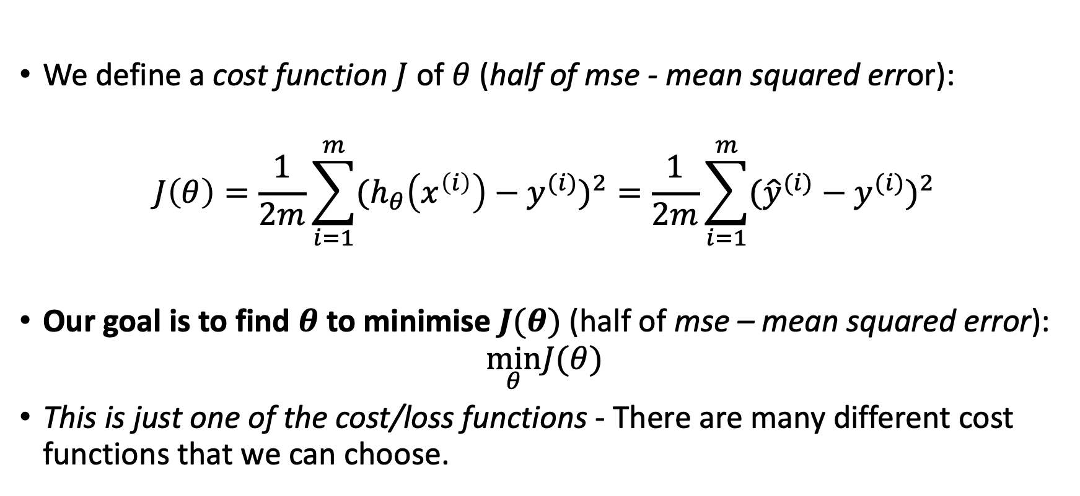
Finding $θ$ to Minimise a Cost/Loss Function
We define a cost function $J$ of $θ$ (half of mse - mean squared error):
$$J\left(θ\right)=\frac{1}{2m}{\sum_{i=1}^{m}{{(h_{θ}\left(x^{\left(i\right)}\right)−y^{(i)})}^{2}}}=\frac{1}{2m}\sum_{i=1}^{m}{{({\hat{y}}^{(i)}−y^{(i)})}^{2}}$$
Our goal is to find $θ$ to minimise $J(θ)$ (half of mse – mean squared error):
$$\min_{θ}J(θ)$$
This is just one of the cost/loss functions - There are many different cost functions that we can choose.

Slide 12
End of Week 1

Slide 13

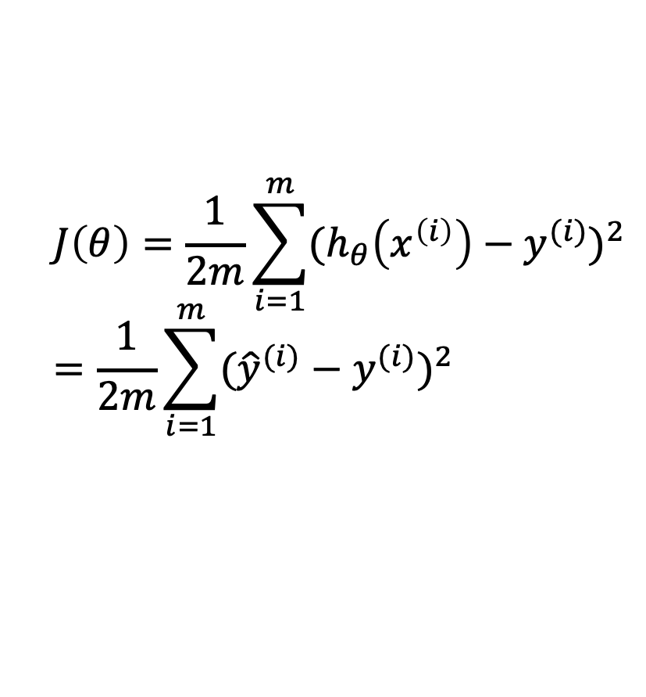


Mean Squared Error – An Example
$$J\left(θ\right)=\frac{1}{2m}{\sum_{i=1}^{m}{{(h_{θ}\left(x^{\left(i\right)}\right)−y^{(i)})}^{2}}}=\frac{1}{2m}\sum_{i=1}^{m}{{({\hat{y}}^{(i)}−y^{(i)})}^{2}}$$
2.0
1.5
Error
1.0
0.5
1.0
0.5
0.0
0.0
0.5
1.0
$$w_{1}$$
-0.5
-1.0
$$w_{0}$$
1.5
2.0
The MSE plotted in a parameter/weight space.

Slide 14
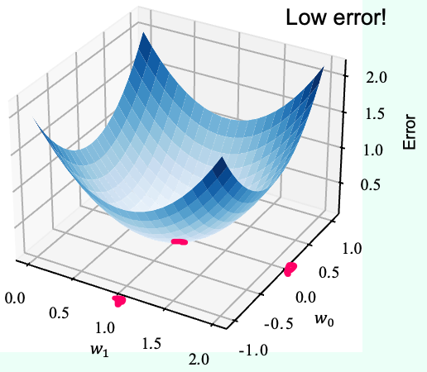


Mean Squared Error – An Example
High error!
2.0
1.5
Error
1.0
0.5
1.0
0.5
0.0
0.0
0.5
1.0
$$w_{1}$$
-0.5
-1.0
$$w_{0}$$
1.5
2.0
W=[w₀ w₁]=[1.0, 2.0]
W=[w₀ w₁]=[0.25, 1.0]

Slide 15
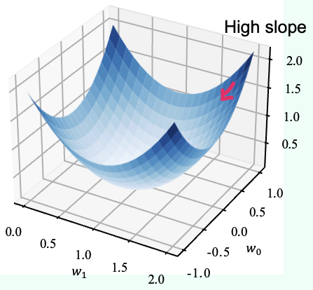
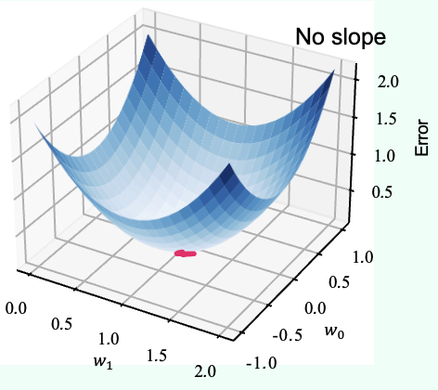
Gradient Descent – An Illustration
The negative of the gradient (the red line) represents the steepest descent which is getting less and less steep with less and less altitude reduced as the descent is repeated in each step. When the decent is near a local minimum the slope becomes very flat with very little altitude reduced (think of a plateau), the algorithm converges.
Notes:
Remember that a set of weights is a vector which has a magnitude and a direction.

Slide 16





Gradient Descent for Finding $θ$ – An Illustration
2.0
2.0
1.5
1.5
Error
Error
1.0
1.0
0.5
0.5
1.0
1.0
0.5
0.5
0.0
0.0
0.0
0.0
0.5
0.5
1.0
$$w_{1}$$
-0.5
-1.0
$$w_{0}$$
1.0
$$w_{1}$$
-0.5
-1.0
$$w_{0}$$
1.5
1.5
2.0
2.0

Slide 17
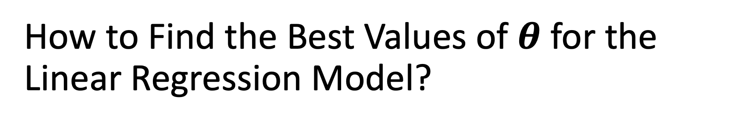
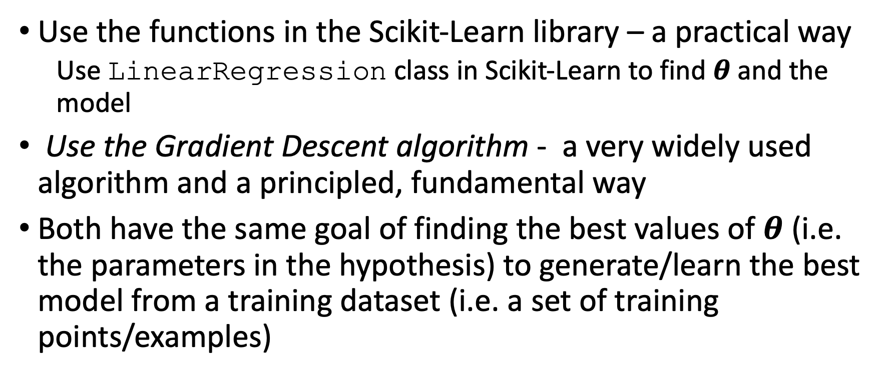
How to Find the Best Values of $θ$ for the Linear Regression Model?
Use the functions in the Scikit-Learn library – a practical way
  Use LinearRegression class in Scikit-Learn to find $θ$ and the model
Use the Gradient Descent algorithm - a very widely used algorithm and a principled, fundamental way
Both have the same goal of finding the best values of $θ$ (i.e. the parameters in the hypothesis) to generate/learn the best model from a training dataset (i.e. a set of training points/examples)

Slide 18

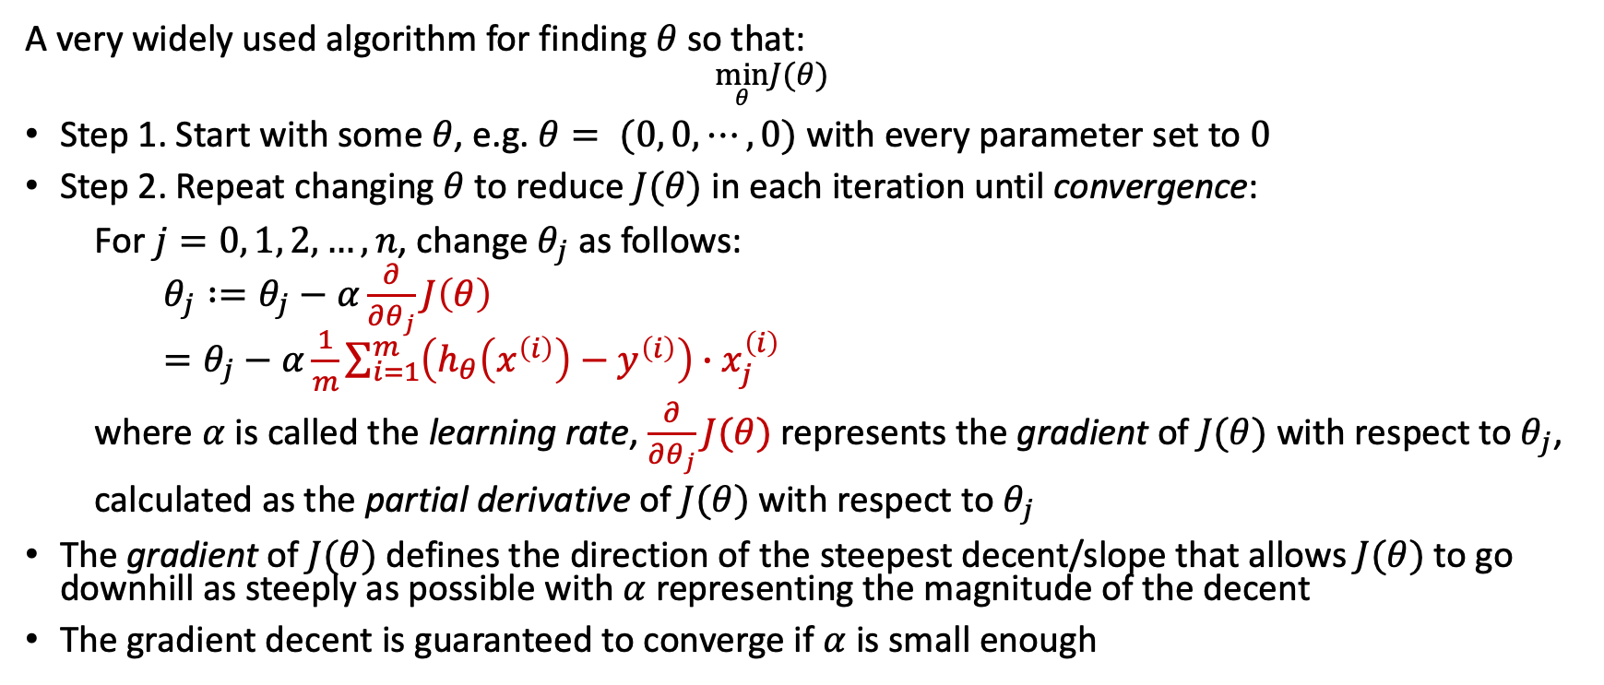
Gradient Descent for Finding $θ$
A very widely used algorithm for finding $θ$ so that:
  $$\min_{θ}J(θ)$$
Step 1. Start with some $θ$, e.g. $θ= (0, 0, ⋯, 0)$ with every parameter set to $0$
Step 2. Repeat changing $θ$ to reduce $J(θ)$ in each iteration until convergence:
  For $j=0, 1, 2, …, n$, change $θ_{j}$ as follows:
  $θ_{j} :=θ_{j}−α\frac{∂}{∂θ_{j}}J\left(θ\right)$
  $=θ_{j}−α\frac{1}{m}\sum_{i=1}^{m}{\left(h_{θ}\left(x^{\left(i\right)}\right)−y^{\left(i\right)}\right)∙x_{j}^{\left(i\right)}}$
  where $α$ is called the learning rate, $\frac{∂}{∂θ_{j}}J(θ)$ represents the gradient of $J(θ)$ with respect to $θ_{j}$, calculated as the partial derivative of $J(θ)$ with respect to $θ_{j}$
The gradient of $J(θ)$ defines the direction of the steepest decent/slope that allows $J(θ)$ to go downhill as steeply as possible with $α$ representing the magnitude of the decent
The gradient decent is guaranteed to converge if $α$ is small enough
Notes:
Think of the learning rate as the distance of your walking per step, i.e. how far you walk in each step, and you are given the direction of the steepest decent in terms of east-west ($θ_{0}$), and north-south ($θ_{1}$) directions, you can work out where you are, say after 1 step of walking in the direction.
We don’t need to worry about how the formula for calculating the gradient is derived.

Slide 19
Cost Function is a Continuous, Convex Function
A convex function - The line joining any two points on the curve never crosses the curve
  This implies that there is no local minima, just one global minimum. It is also a continuous function with a slope that never changes abruptly
  Gradient Descent is guaranteed to approach arbitrarily close to the global minimum (if you wait long enough and if the learning rate is not too high)

Slide 20
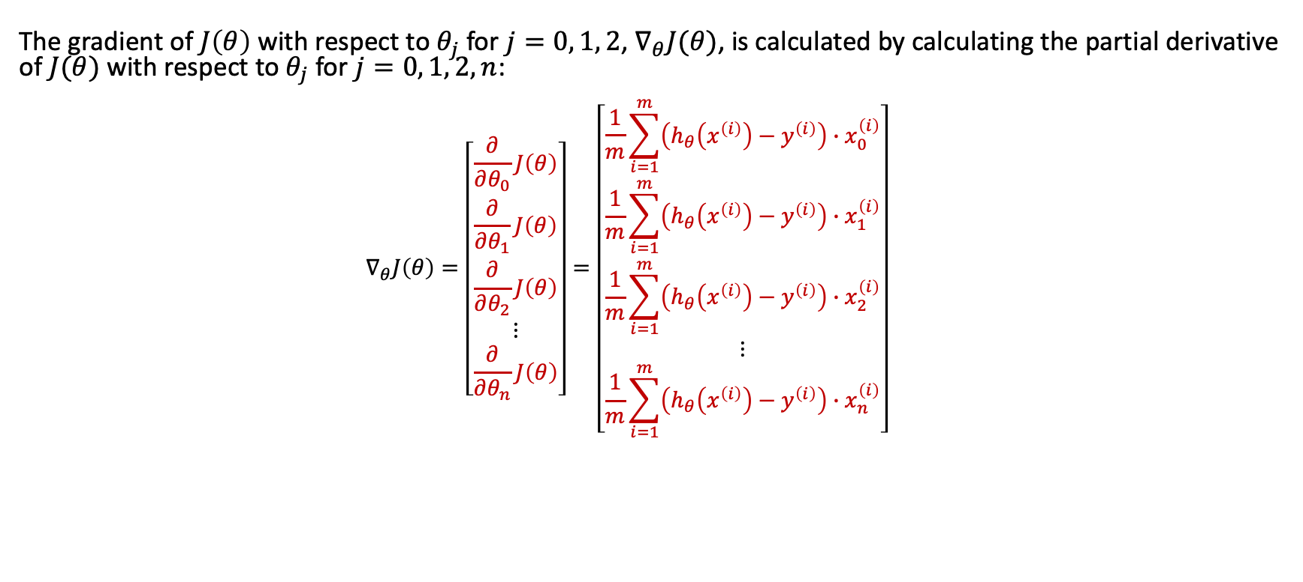
Gradient Descent – Calculating Gradient
The gradient of $J\left(θ\right)$ with respect to $θ_{j}$ for $j=0, 1, 2$, $∇_{θ}J(θ)$, is calculated by calculating the partial derivative of $J(θ)$ with respect to $θ_{j}$ for $j=0, 1, 2, n$:
  $$∇_{θ}J\left(θ\right)=\left[\begin{aligned}\begin{matrix}\begin{aligned}\frac{∂}{∂θ_{0}}J\left(θ\right) \\ \frac{∂}{∂θ_{1}}J\left(θ\right)\end{aligned} \\ \frac{∂}{∂θ_{2}}J\left(θ\right) \\ ⋮\end{matrix} \\ \frac{∂}{∂θ_{n}}J\left(θ\right)\end{aligned}\right]=\left[\begin{aligned}\begin{matrix}\begin{aligned}\frac{1}{m}\sum_{i=1}^{m}{\left(h_{θ}\left(x^{\left(i\right)}\right)−y^{\left(i\right)}\right)∙x_{0}^{\left(i\right)}} \\ \frac{1}{m}\sum_{i=1}^{m}{\left(h_{θ}\left(x^{\left(i\right)}\right)−y^{\left(i\right)}\right)∙x_{1}^{\left(i\right)}}\end{aligned} \\ \frac{1}{m}\sum_{i=1}^{m}{\left(h_{θ}\left(x^{\left(i\right)}\right)−y^{\left(i\right)}\right)∙x_{2}^{\left(i\right)}} \\ ⋮\end{matrix} \\ \frac{1}{m}\sum_{i=1}^{m}{\left(h_{θ}\left(x^{\left(i\right)}\right)−y^{\left(i\right)}\right)∙x_{n}^{\left(i\right)}}\end{aligned}\right]$$

Slide 21
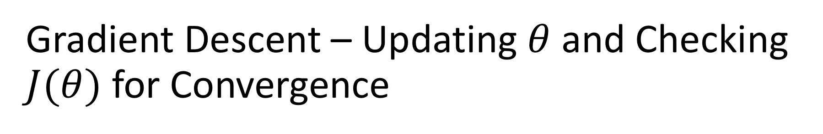
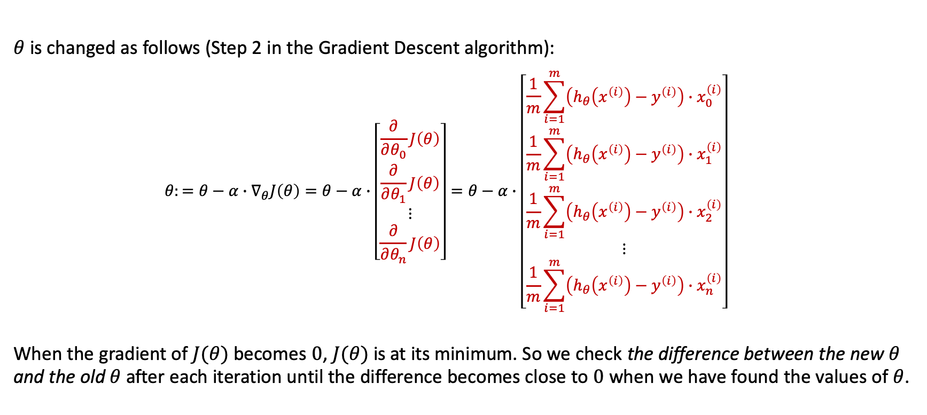
Gradient Descent – Updating $θ$ and Checking $J(θ)$ for Convergence
$θ$ is changed as follows (Step 2 in the Gradient Descent algorithm):
  $${θ:=θ−α∙∇}_{θ}J\left(θ\right)=θ−α∙\left[\begin{aligned}\begin{matrix}\frac{∂}{∂θ_{0}}J\left(θ\right) \\ \frac{∂}{∂θ_{1}}J\left(θ\right) \\ ⋮\end{matrix} \\ \frac{∂}{∂θ_{n}}J\left(θ\right)\end{aligned}\right]=θ−α∙\left[\begin{aligned}\begin{matrix}\frac{1}{m}\sum_{i=1}^{m}{\left(h_{θ}\left(x^{\left(i\right)}\right)−y^{\left(i\right)}\right){∙x}_{0}^{\left(i\right)}} \\ \frac{1}{m}\sum_{i=1}^{m}{\left(h_{θ}\left(x^{\left(i\right)}\right)−y^{\left(i\right)}\right)∙x_{1}^{\left(i\right)}} \\ \frac{1}{m}\sum_{i=1}^{m}{\left(h_{θ}\left(x^{\left(i\right)}\right)−y^{\left(i\right)}\right){∙x}_{2}^{\left(i\right)}}\end{matrix} \\ ⋮ \\ \frac{1}{m}\sum_{i=1}^{m}{\left(h_{θ}\left(x^{\left(i\right)}\right)−y^{\left(i\right)}\right)∙x_{n}^{\left(i\right)}}\end{aligned}\right]$$
  When the gradient of $J(θ)$ becomes $0$, $J(θ)$ is at its minimum. So we check the difference between the new $θ$ and the old $θ$ after each iteration until the difference becomes close to $0$ when we have found the values of $θ$.

Slide 22
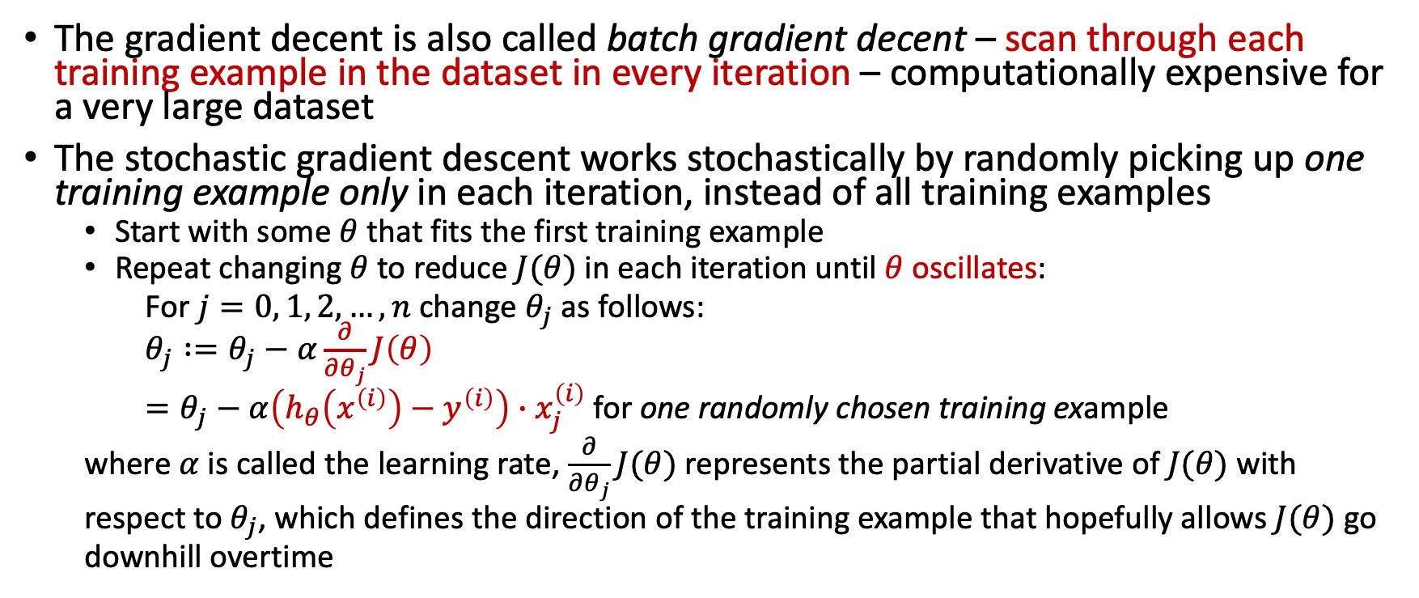
Stochastic Gradient Descent
The gradient decent is also called batch gradient decent – scan through each training example in the dataset in every iteration – computationally expensive for a very large dataset
The stochastic gradient descent works stochastically by randomly picking up one training example only in each iteration, instead of all training examples
  Start with some $θ$ that fits the first training example
  Repeat changing $θ$ to reduce $J(θ)$ in each iteration until $θ$oscillates:
  For $j=0, 1, 2, …, n$ change $θ_{j}$ as follows:
  $θ_{j} :=θ_{j}−α\frac{∂}{∂θ_{j}}J\left(θ\right)$
  $=θ_{j}−α\left(h_{θ}\left(x^{\left(i\right)}\right)−y^{\left(i\right)}\right)∙x_{j}^{\left(i\right)}$ for one randomly chosen training example
  where $α$ is called the learning rate, $\frac{∂}{∂θ_{j}}J(θ)$ represents the partial derivative of $J(θ)$ with respect to $θ_{j}$, which defines the direction of the training example that hopefully allows $J(θ)$ go downhill overtime

Slide 23
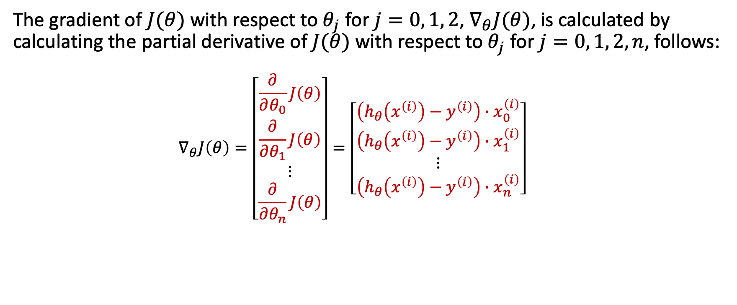
Stochastic Gradient Descent
The gradient of $J(θ)$ with respect to $θ_{j}$ for $j=0, 1, 2$, $∇_{θ}J(θ)$, is calculated by calculating the partial derivative of $J(θ)$ with respect to $θ_{j}$ for $j=0, 1, 2, n$, follows:
  $$∇_{θ}J\left(θ\right)=\left[\begin{aligned}\begin{matrix}\frac{∂}{∂θ_{0}}J\left(θ\right) \\ \frac{∂}{∂θ_{1}}J\left(θ\right) \\ ⋮\end{matrix} \\ \frac{∂}{∂θ_{n}}J\left(θ\right)\end{aligned}\right]=\left[\begin{aligned}\begin{matrix}\left(h_{θ}\left(x^{\left(i\right)}\right)−y^{\left(i\right)}\right)∙x_{0}^{\left(i\right)} \\ \left(h_{θ}\left(x^{\left(i\right)}\right)−y^{\left(i\right)}\right)∙x_{1}^{\left(i\right)} \\ ⋮\end{matrix} \\ \left(h_{θ}\left(x^{\left(i\right)}\right)−y^{\left(i\right)}\right)∙x_{n}^{\left(i\right)}\end{aligned}\right]$$

Slide 24

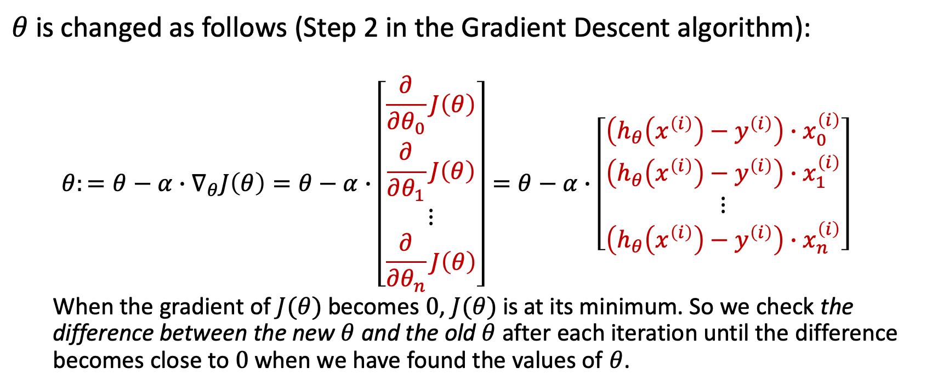
Stochastic Gradient Descent – Updating $θ$ and Checking $J(θ)$ for Convergence
$θ$ is changed as follows (Step 2 in the Gradient Descent algorithm):
  $${θ:=θ−α∙∇}_{θ}J\left(θ\right)=θ−α∙\left[\begin{aligned}\begin{matrix}\frac{∂}{∂θ_{0}}J\left(θ\right) \\ \frac{∂}{∂θ_{1}}J\left(θ\right) \\ ⋮\end{matrix} \\ \frac{∂}{∂θ_{n}}J\left(θ\right)\end{aligned}\right]=θ−α∙\left[\begin{aligned}\begin{matrix}\left(h_{θ}\left(x^{\left(i\right)}\right)−y^{\left(i\right)}\right)∙x_{0}^{\left(i\right)} \\ \left(h_{θ}\left(x^{\left(i\right)}\right)−y^{\left(i\right)}\right)∙x_{1}^{\left(i\right)} \\ ⋮\end{matrix} \\ \left(h_{θ}\left(x^{\left(i\right)}\right)−y^{\left(i\right)}\right)∙x_{n}^{\left(i\right)}\end{aligned}\right]$$
  When the gradient of $J(θ)$ becomes $0$, $J(θ)$ is at its minimum. So we check the difference between the new $θ$ and the old $θ$ after each iteration until the difference becomes close to $0$ when we have found the values of $θ$.

Slide 25
Summary
Linear regression
Notation of ML algorithms
Learning parameters by gradient descent
Batch gradient descent needs to scan over all training examples in each iteration until the cost function converges
Stochastic gradient descent randomly chooses one example only in each iteration until the cost function converges

Slide 26
References
Chapter 4. Training Models in Hands-on ML

Slide 27
Resources
Andrew Ng’s Machine Learning Course
  Lecture 2 - Linear Regression and Gradient Descent
  A good video for linear regression https://www.youtube.com/watch?v=4b4MUYve_U8
Introduction to Derivatives
  Look at this only if you find it fun
  https://www.mathsisfun.com/calculus/derivatives-introduction.html

